Slide 1




Update Improving Contraceptive Method Mix (ICMM) Project

Slide 2
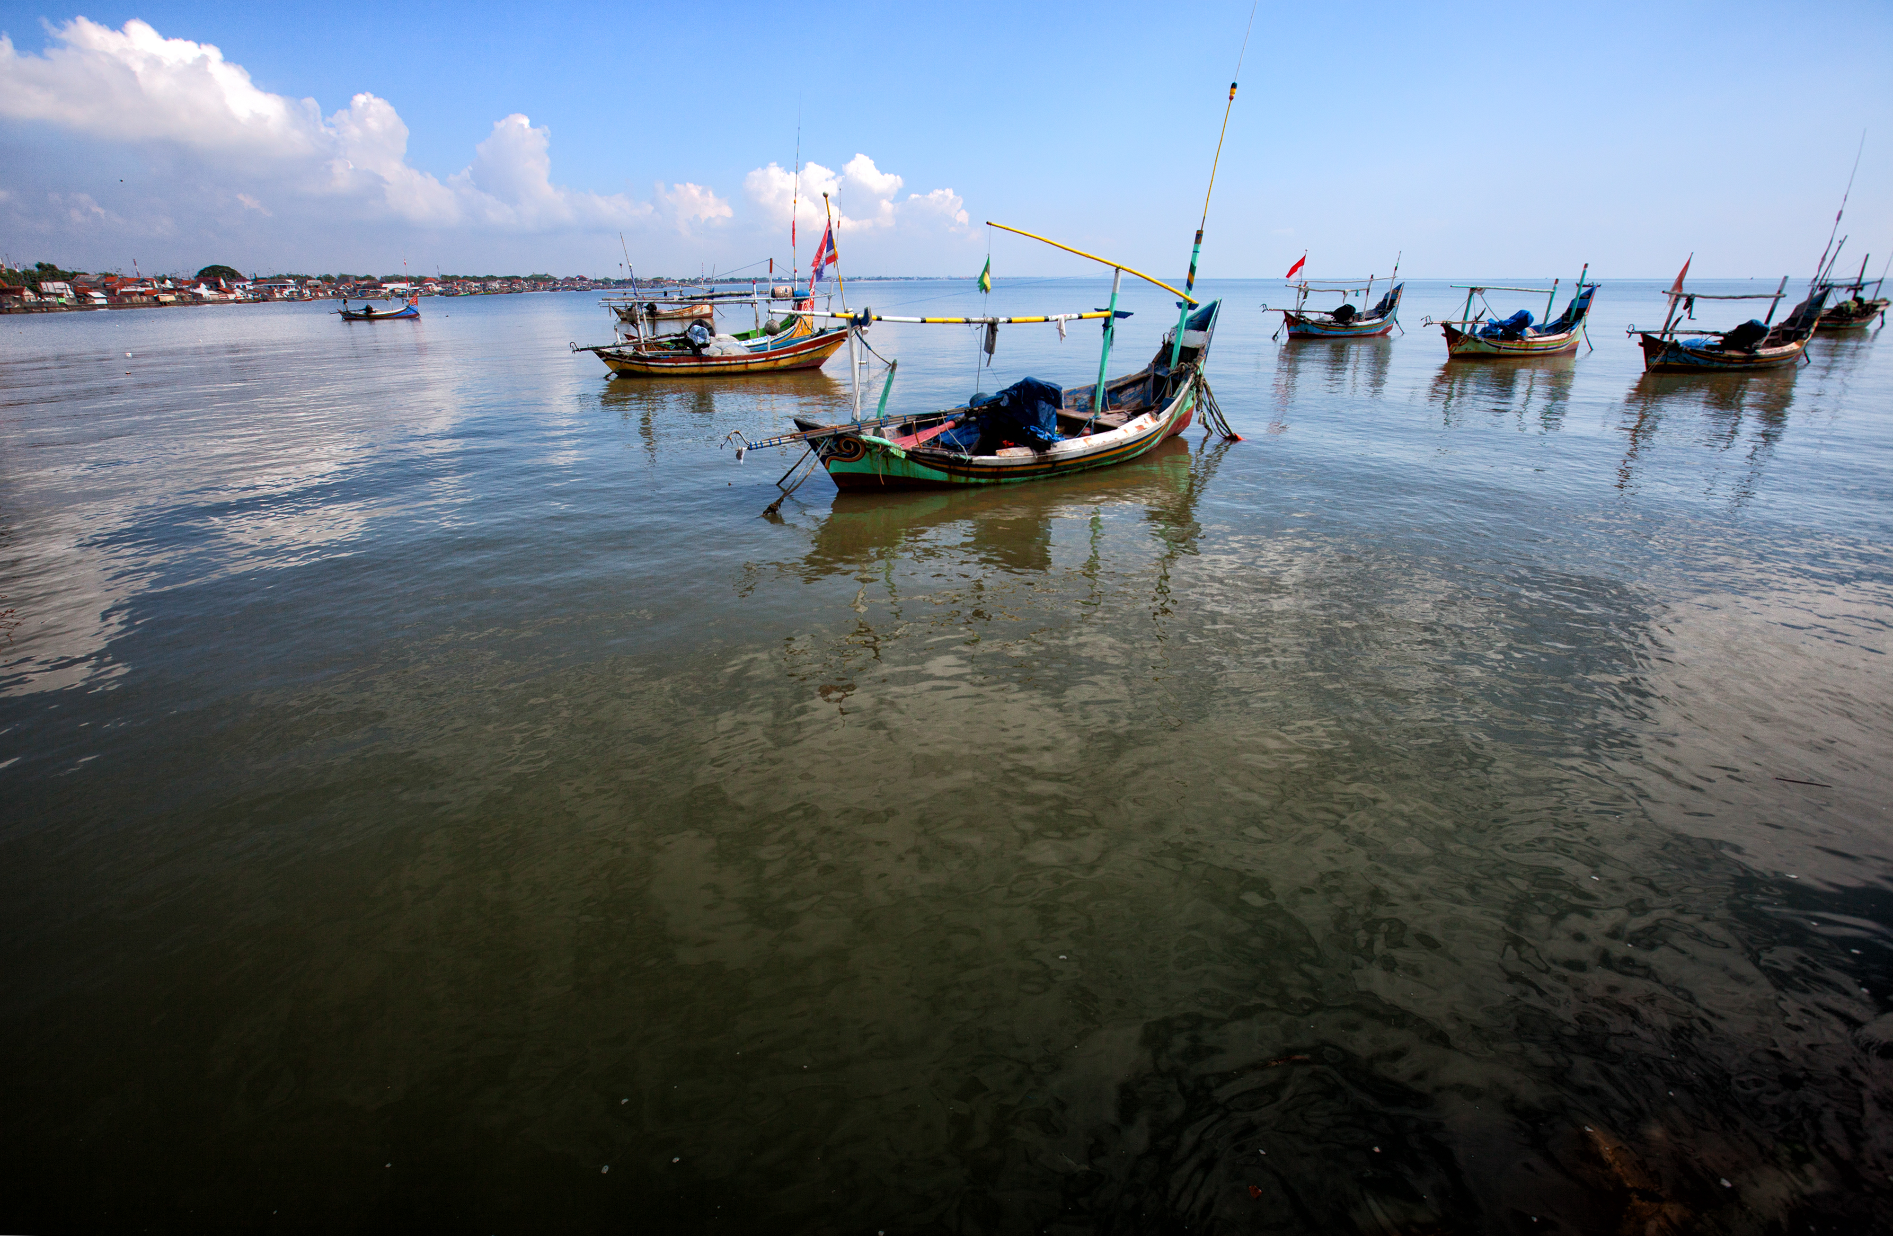
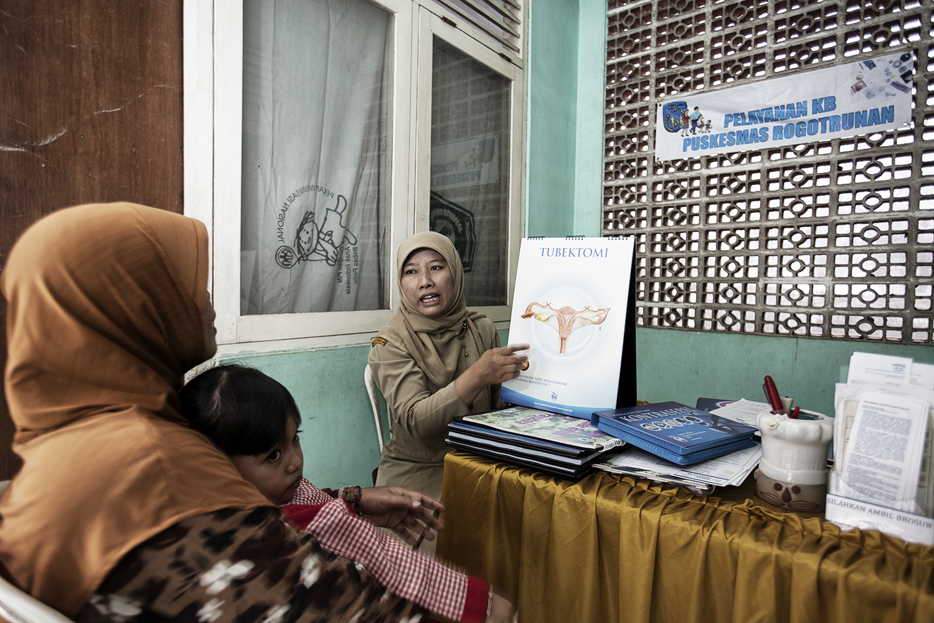
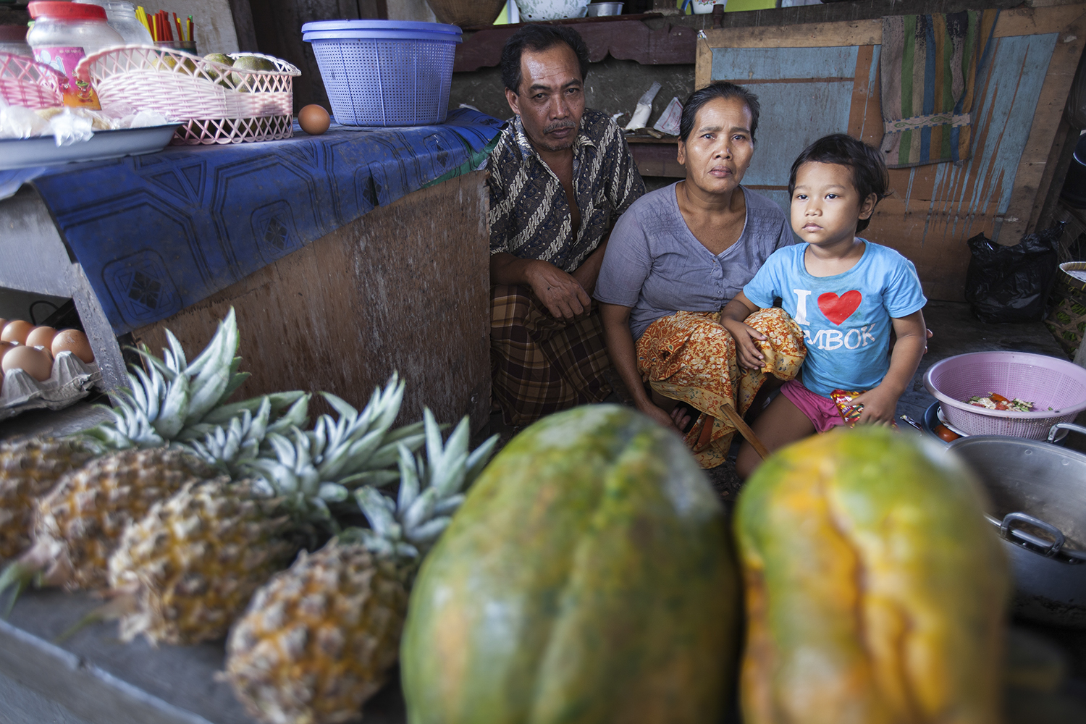
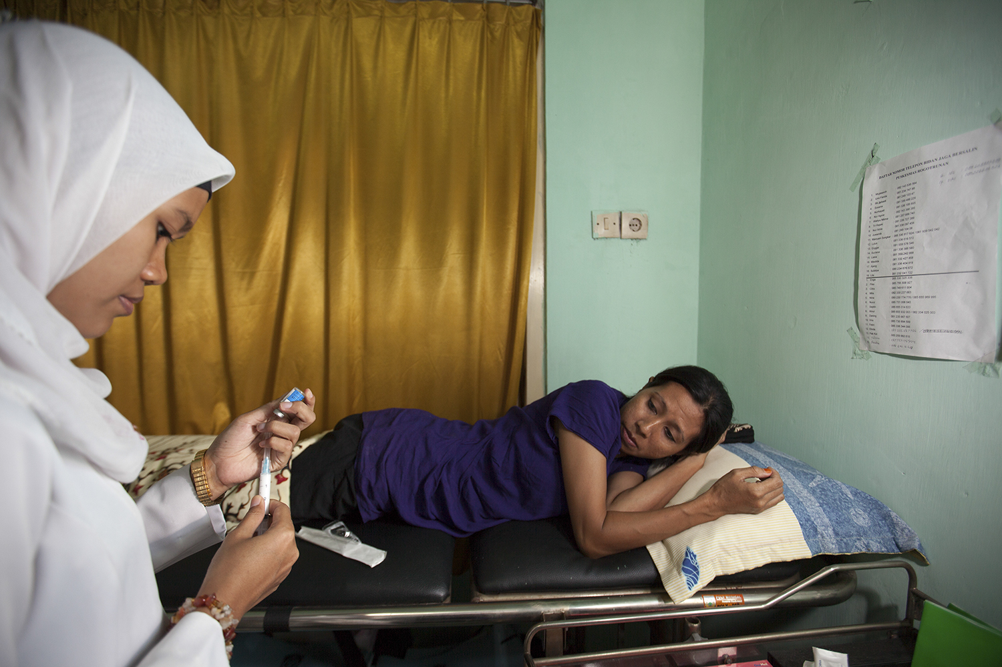
ICMM Background
Design: Operations research and advocacy project with a knowledge management component
Uses AFP methodology for advocacy approach
Project duration: 2012 – 2016

Slide 3
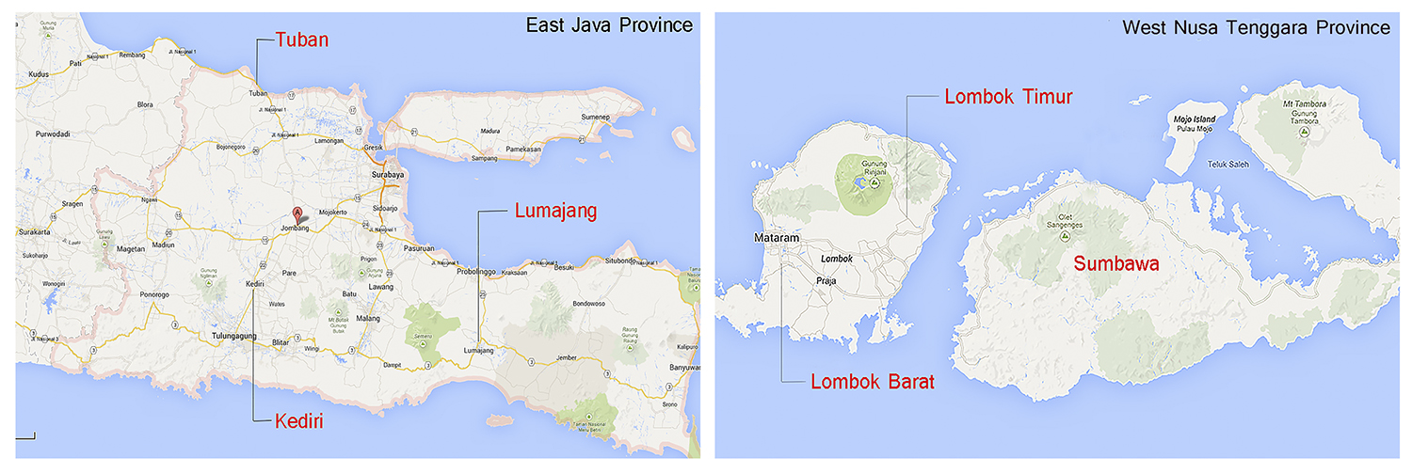
Project Area
Location:
East Java: Intervention (Tuban, Lumajang, Kediri)
- Control area: Jombang, Bojonegoro, Blitar ;
West Nusa Tenggara: Intervention (Lombok Timur, Sumbawa, Lombok Barat)
- Control area: Lombok Utara, Bima, Lombok Tengah

Slide 4
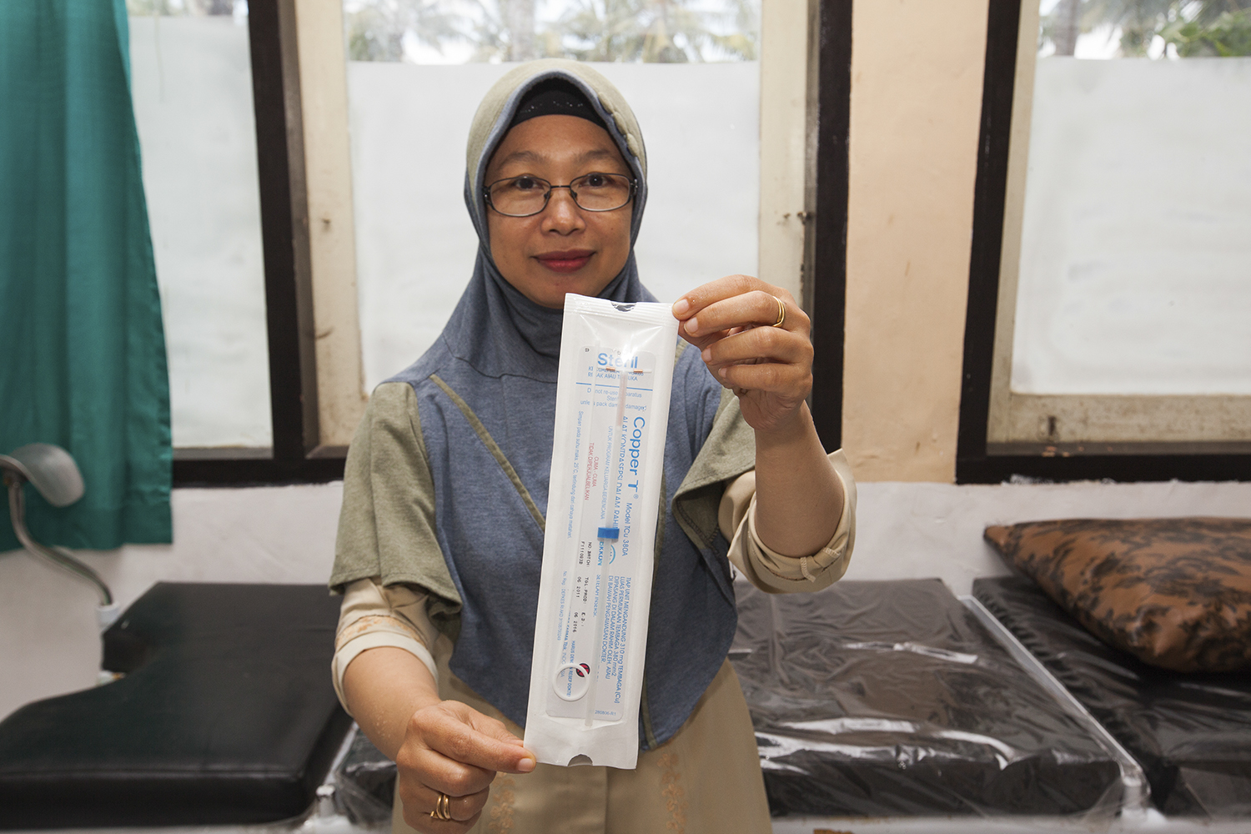
Project Objectives
To increase the use of LAPMs in Indonesia
To document the effectiveness of district-level advocacy in increasing support for LAPMs
To support evidence-based advocacy plans for the district level
To develop an advocacy training and support package for use in other districts

Slide 5
ICMM Activity
Advocacy
Sharing knowledge & experience
Research
Notes:
ICMM originated in conversations among AFP, USAID, and DFAT (formerly AusAID)—several years back, and officially began in late 2012 under K4Health core funding. We then received an Associate Award which began in September 2013 and goes through September 2016—so it is a four-year project in total. The project is funded by USAID (the lead donor) as well as DFAT. We receive additional support and technical assistance from AFP - AFP also worked to design the ICMM project, using its advocacy tools and approach.

Slide 6
Update on Advocacy Issue
Advocacy for increasing budget using the village budget (ADD)
Demand : promote LAPM use
Service availability (CTU training)

Slide 7
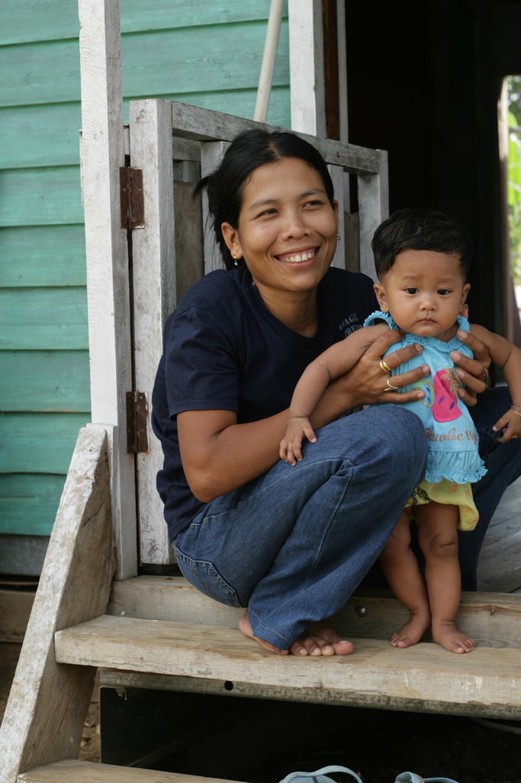
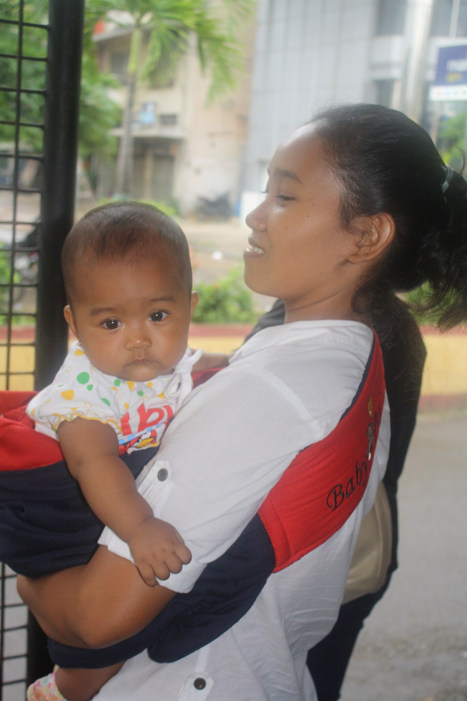
Terima Kasih!

